Slide 1
Welcome to MATLAB

Slide 2
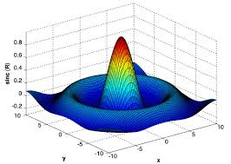
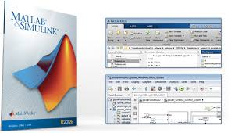

Slide 3
What is MATLAB?
Matlab = Matrix Laboratory
A software environment for interactive numerical computations
Examples:
Matrix computations and linear algebra
Solving nonlinear equations
Numerical solution of differential equations
Mathematical optimization
Statistics and data analysis
Signal processing
Modelling of dynamical systems
Solving partial differential equations
Simulation of engineering systems

Slide 4
Why MATLAB – Why in ECE?
Core Programming language for Electronics and Communication system design
Popular tool used for engineering research after C (Includes embedded C), Java
Lot of Job opportunities in india and abroad

Slide 5
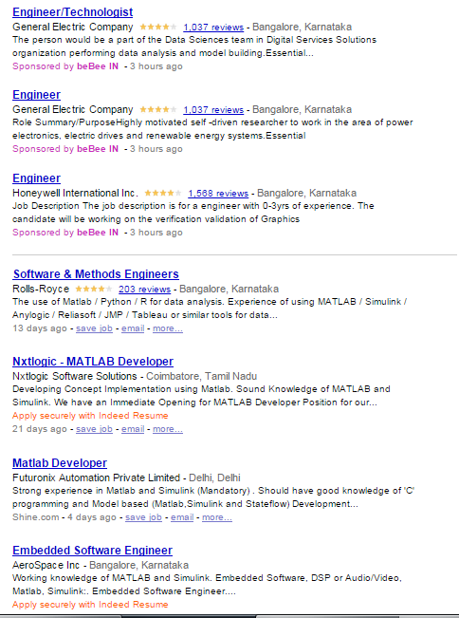
Job Opportunities

Slide 6
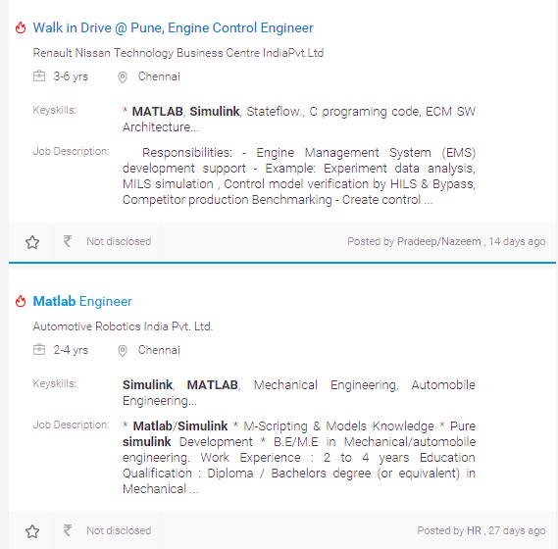
Job Opportunities

Slide 7
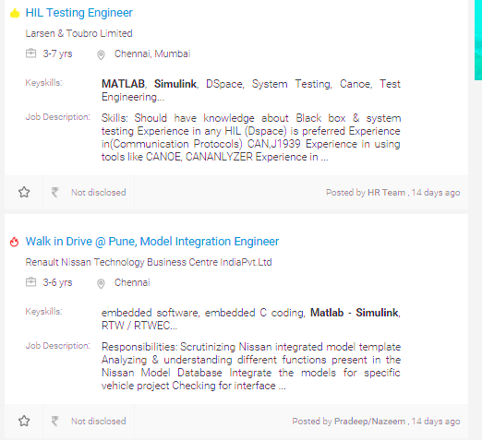
Job Opportunities

Slide 8
Job Opportunities
Positions You can Get
Major Companies
System Engineer
Design Engineer
MATLAB developer
Research Analyst
Control Engineer
Simulink Developer
Test Engineer
Data Analyst
Bio informatics scientist
Control Engineer
Amazon, Alcatel Lucent
GE, L&T, Vestas, Mu sigma
AT&T, Ericsson, 3GPP
Renault & Nissan
ATMEL, INTEL, ARM
Infosys, Wipro, TATA ELXi, Accenture
Boeing, Airbus
Robert Bose etc…

Slide 9
MATLAB Toolboxes
MATLAB has a number of add-on software modules, called toolboxes, that perform more specialized computations.
Signal & Image Processing
Signal Processing- Image Processing Communications - System Identification - Wavelet Filter Design
Communication
Analog and Digital Modulation
Source and Channel Coding
Channel Modeling and RF Impairments
Equalization and Synchronization
Stream Processing in MATLAB and Simulink
Implementing a Communications System
More than 60 toolboxes!

Slide 10
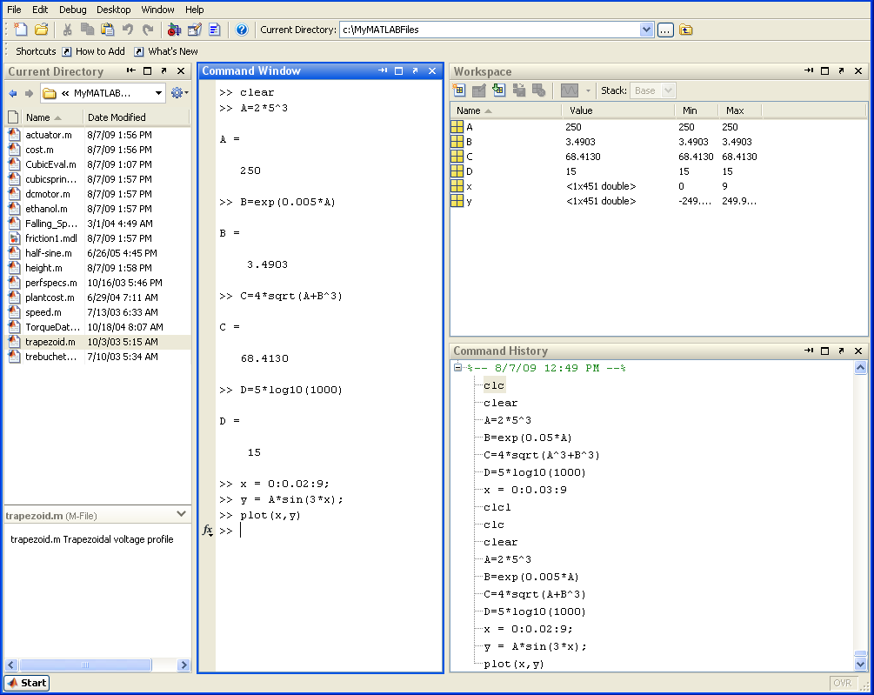
Matlab Desktop (<=R2012a)

Slide 11
Matlab Desktop (>=R2012b)

Slide 12
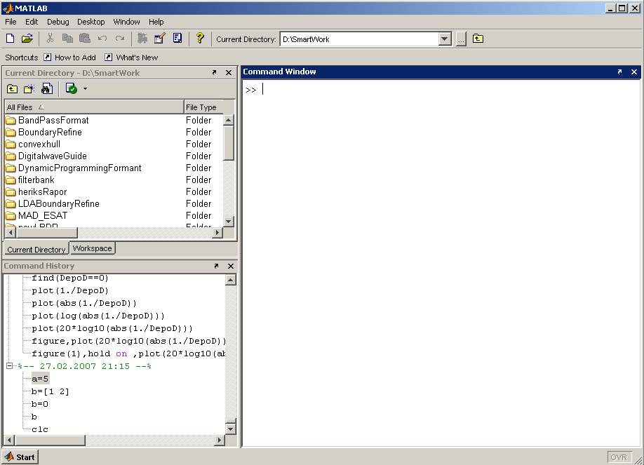
Matlab Screen
Command Window
type commands
Current Directory
View folders and m-files
Workspace
View program variables
Double click on a variable
to see it in the Array Editor
Command History
view past commands
save a whole session
using diary

Slide 13
MATLAB
Command
Window

Slide 14
File

Slide 15
Edit

Slide 16
View

Slide 17
View

Slide 18
View

Slide 19
Web

Slide 20
Help

Slide 22
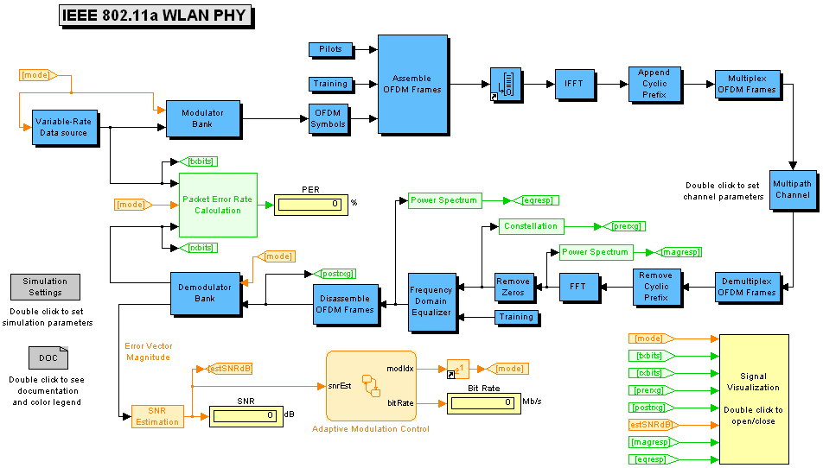
Simulink
Simulink - a package for modeling dynamic systems
Notes:
Simulink is a program that runs as a companion to MATLAB, these programs are developed and marketed by the MathWorks, Inc. Simulink and MATLAB form a package that serves as a vehicle for modeling dynamic systems. Simulink provides a graphical user interface (GUI) that is used in building block diagrams, performing simulations, as well as analyzing results.

Slide 23
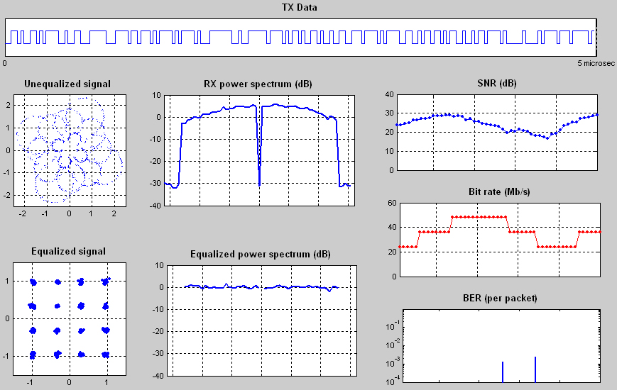
Simulink (cont‘d)
Analyzing results:
Notes:
Simulink is a program that runs as a companion to MATLAB, these programs are developed and marketed by the MathWorks, Inc. Simulink and MATLAB form a package that serves as a vehicle for modeling dynamic systems. Simulink provides a graphical user interface (GUI) that is used in building block diagrams, performing simulations, as well as analyzing results.

Slide 24
Construction
Core functionality: compiled C-routines
Most functionality is given as m-files, grouped into toolboxes
m-files contain source code, can be copied and altered
m-files are platform independent (PC, Unix/Linux, MAC)
Simulation of dynamical systems is performed in Simulink

